Slide 1
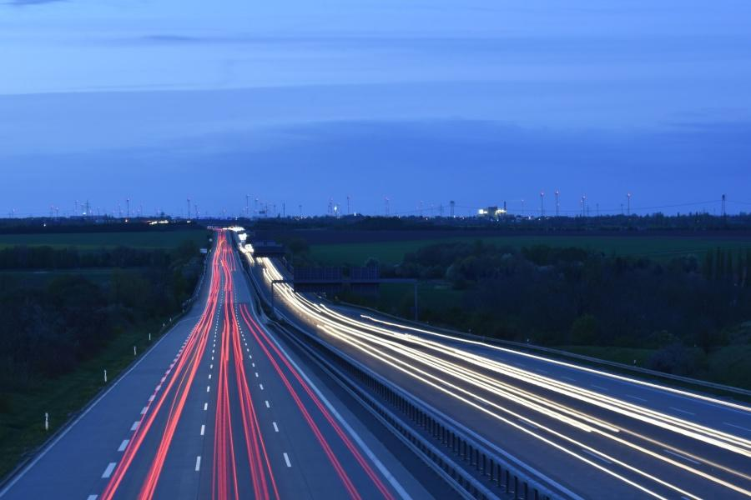
Routes Less Taken Inc.
Jorge Ruan
David Mejia
Branden Ford
Gilbert Galvez

Slide 2
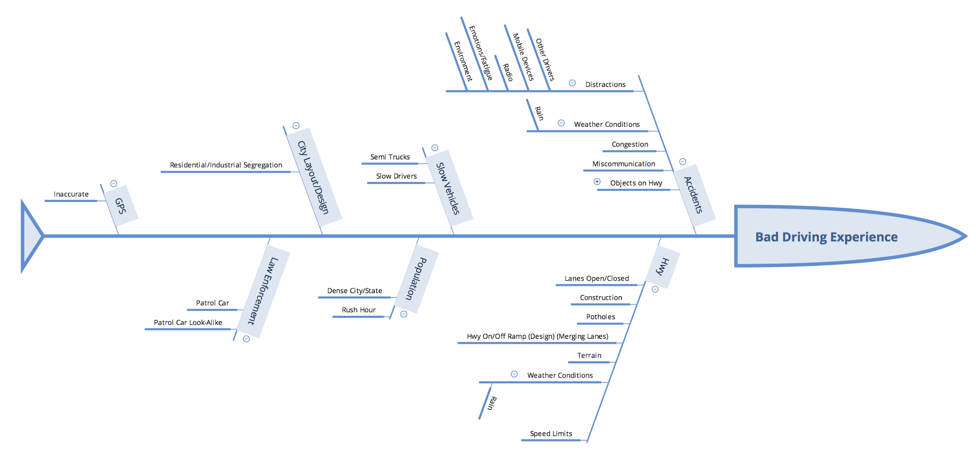
Notes:
There are several factors causing traffic, accidents and an overall terrible driving experience. After re-evaluating them, we realized that much of the traffic, is caused by accidents and construction. As we dive deeper into the problem, we wanted to focus our attention more on the problems of construction. Construction causes delays and accidents on a daily basis. There are no convenient ways of informing drivers of future construction plans.

Slide 3
BUSINESS MOTIVATION MODEL
MEANS
END
Mission: Having a more efficient and less stressful driving experience.
VISION: To allow drivers to reach their destinations in a more efficient time in order to improve the driver experience.
Course of action
Strategy: Creating a subscription based service that enables users to receive messages via sms or AI voice.
DESIRED RESULT
GOAL: “Reduce traffic by informing our users of important traffic information”
Tactic: Utilizing the Department of Transportation database to alert the user of any traffic due to construction on his or her route.
DIRECTIVE
OBJECTIVE:
Utilize the Department of Transportation database and present only the relevant information to the user according to their current route.
Business Policy: 1. Privacy and Personal Rights 2. Adherence with Federal, State, and Local Laws
Business Rule: 1.Do not access or copy user’s email or phone numbers 2. Abide by all federal, state and local laws
ASSESSMENT
INFLUENCER
With the amount traffic, there is a need for more advanced ways of informing drivers. There are websites that contain the information necessary but there is no software that makes a realistic use of this information. The ability to gather only the relevant information to the driver at any given time is the key to a successful program
EXTERNAL: 1.Competition: Google Maps/Waze, 2.Technology: Smartphones,
INTERNAL: 1.Infrastructure, 2. Resource,
3. Management.
Notes:
This BMM helps us understand how the program will operate and how the different departments will be working together. The means section describes the main strategy and tactics that might be utilized and the plan to accomplish such goal.
The directive allows us to see the set of policies and rules under which we will operate. Influencer is the section that describes the factors that might have a positive or negative influence on our business.
END section shows us a clear picture of what the final service will provide. This allows for different team members to work toward a common goal.
ASSESSMENT is a quick research outcome that states the issue at hand and how it will be solved with our program.

Slide 4
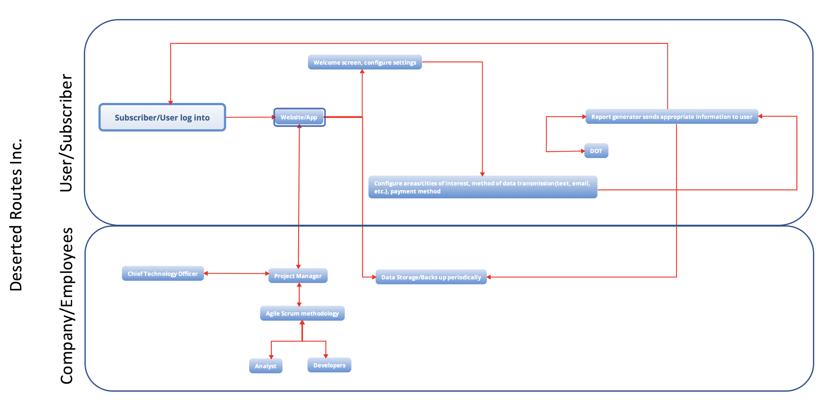
BPMN
Notes:
The BPMN allows to oversee the process that occurs when a user makes an inquiry or simply logs into the system. This allows us to get a graphical idea of the departments and resources that would need to be working together in order to provide such service.
The user creates an account and logs into the system.
The user gets access to the welcome screen and configure settings for possible routes, payment method and notification mode.
The report generator automatically gathers the inquiry and compares it with the DOT database if any construction is found along the present route a notification alert will be sent back to the user.
Through the whole process the system is being supervised by analysts and developers supervised by a Chief Technology officer and Project Managers.

Slide 5
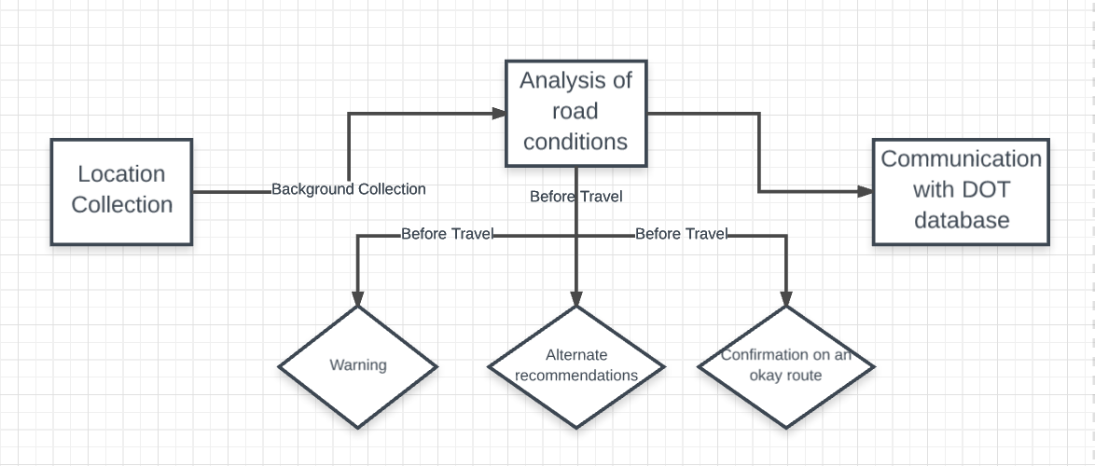
Data Flow Diagram
Notes:
This data flow diagram represents the flow of data from the user to our retrieval of related information which is then relayed back to the user. The user’s location is periodically collected to provide the best routes possible. We will use the location collection to perform an analysis of the road conditions which is retrieved from the DOT database. After the information is analyzed our system will inform the user in the form of a text message through the use of warnings, alternate recommendations and confirmation on current routes.

Slide 6
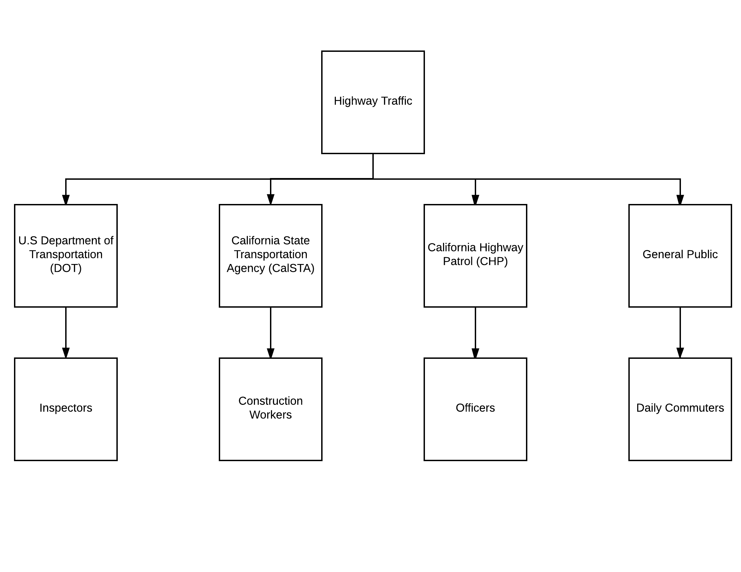
Organizational Chart
Notes:
There are 4 major groups that are involved with highways. The DOT, CalSTA, CHP and the general public. The DOT helps with supporting/advising state and local governments in the design, construction, and maintenance of the nation's highway system. CalSTA manages California's highways with the actual construction and maintenance. CHP enforces traffic and safety laws by issuing citations. Also assists distressed motorists. The general public are the motorists who utilize the highway systems to get to their destinations.

Slide 7
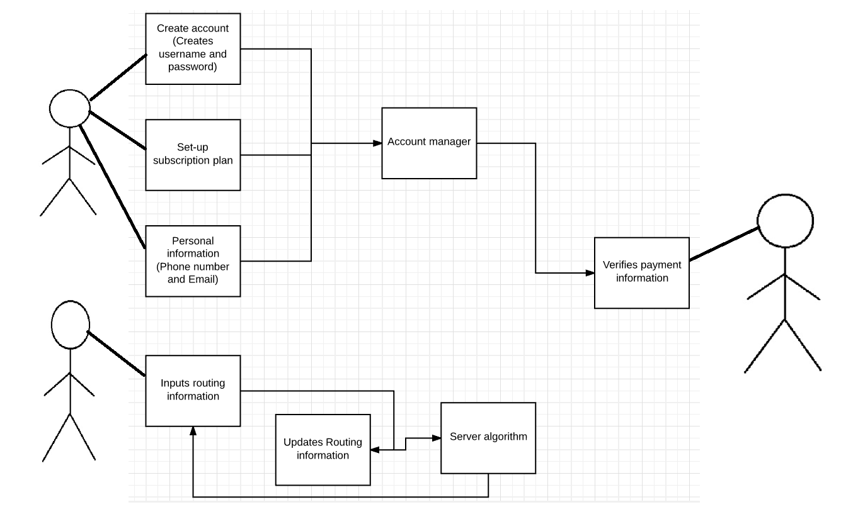
Use Case Diagram
Notes:
The use case diagram depicts the interactions between the user and our system. From the input of financial information to the collection of the user’s location.

Slide 8
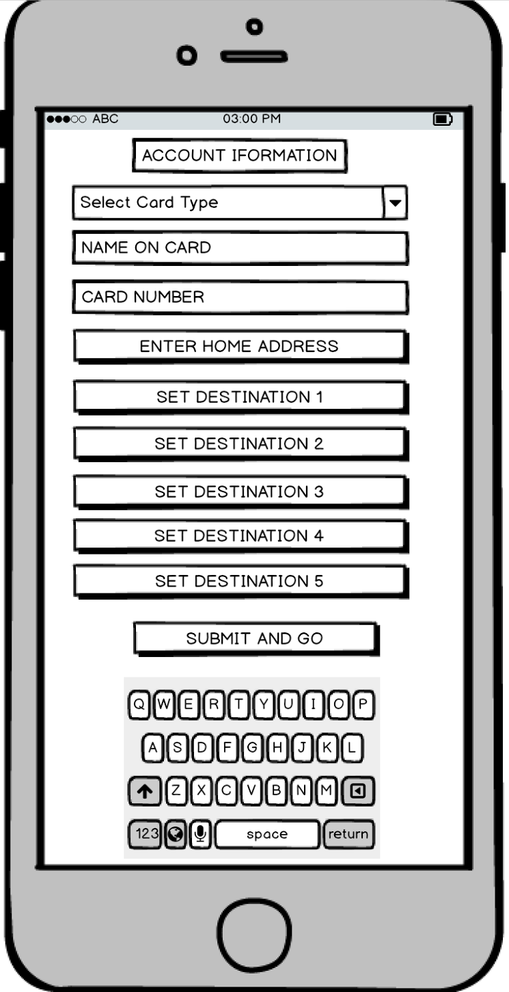
SETTING UP THE ACCOUNT
Notes:
The app will be kept as simple as possible to ensure realistic use by any demographic. Today there are way too many apps out there and no one knows which apps to keep. People will download a ton of apps but only a few will endure the time challenge. In order for an app to be used it has to solve a problem and not add to the complexity of life.

Slide 9
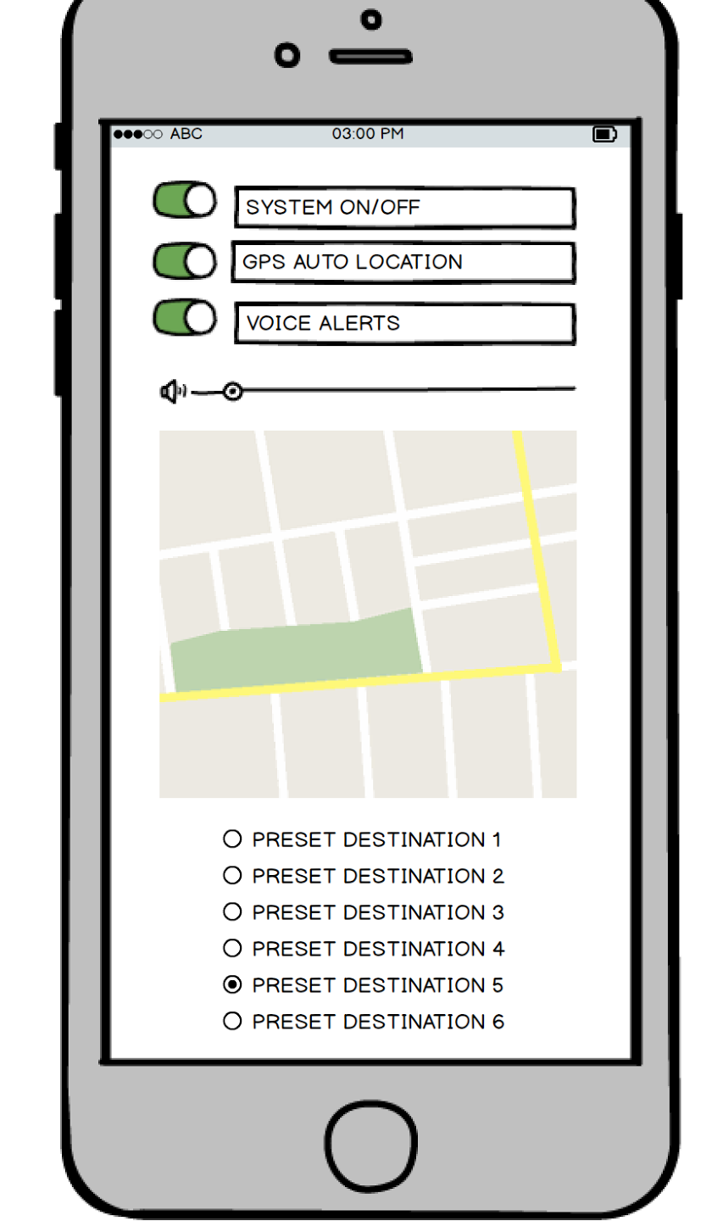
PHONE USER INTERFACE
Notes:
This would be the phone interface that the user would have access to. The destinations may be set either online or under the screen on the previous slide. Once the app has been activated it will operate in the background and only take action when necessary.

Slide 10
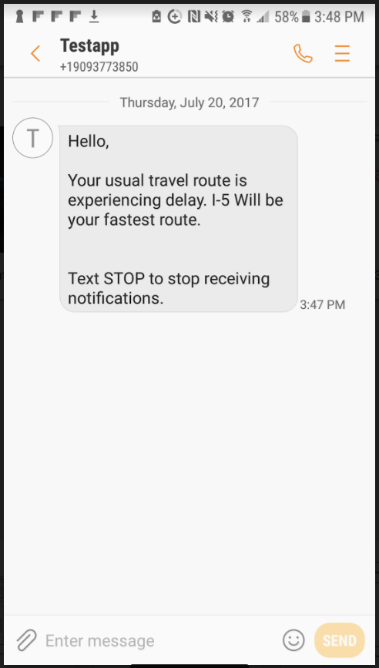
SAMPLE NOTIFICATION
Notes:
An example notification of what a customer would receive should there be a faster route available.

Slide 11
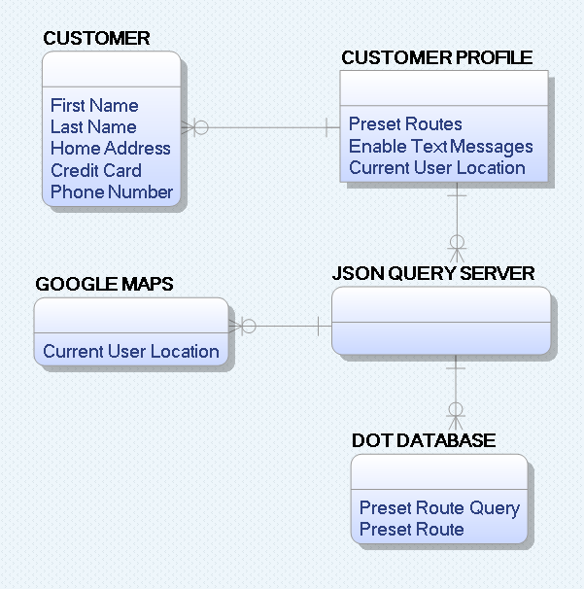
Entity Relationship Diagram
Notes:
This is a diagram demonstrating the relationships between various entities such as customer, customer profile, JSON query server, DOT database and Google Maps.

Slide 12
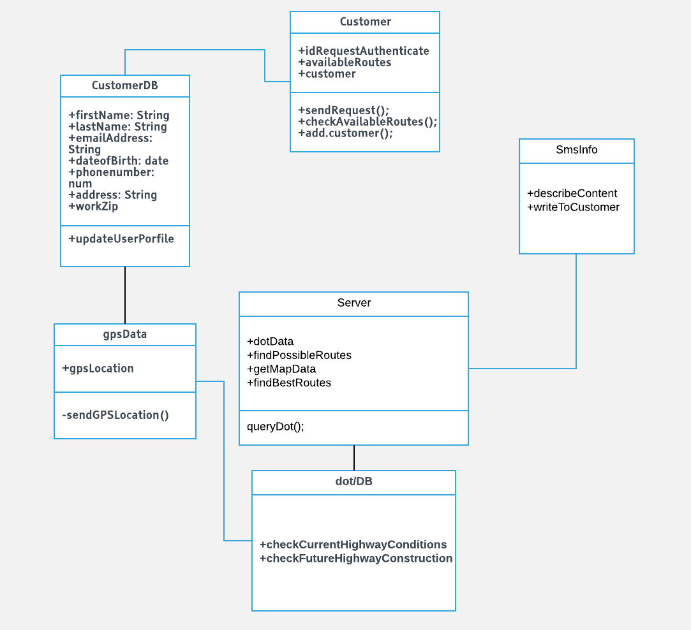
Class Diagram
Notes:
This class diagram describes the core software architecture of our application. The customer class has attributes such as customer and requestauthenticate which connects to our CustomberDB class. This class has attributes involving basic customer information which leads to the gpsData class. This class gathers the user location and connects to the dot/DB class. The class gathers data for the dot and sends it the server class which is connected to the smsinfo class, which sends a text to the customer.

Slide 13
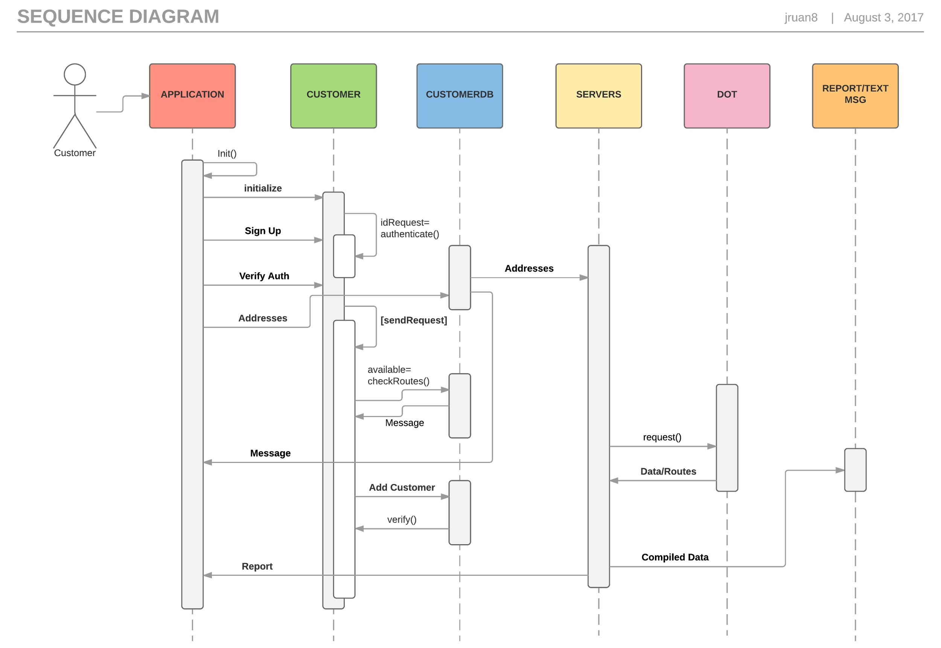
Notes:
Use-case scenario to run parallel with sequence, helps identify how our app should unfold.

Slide 14
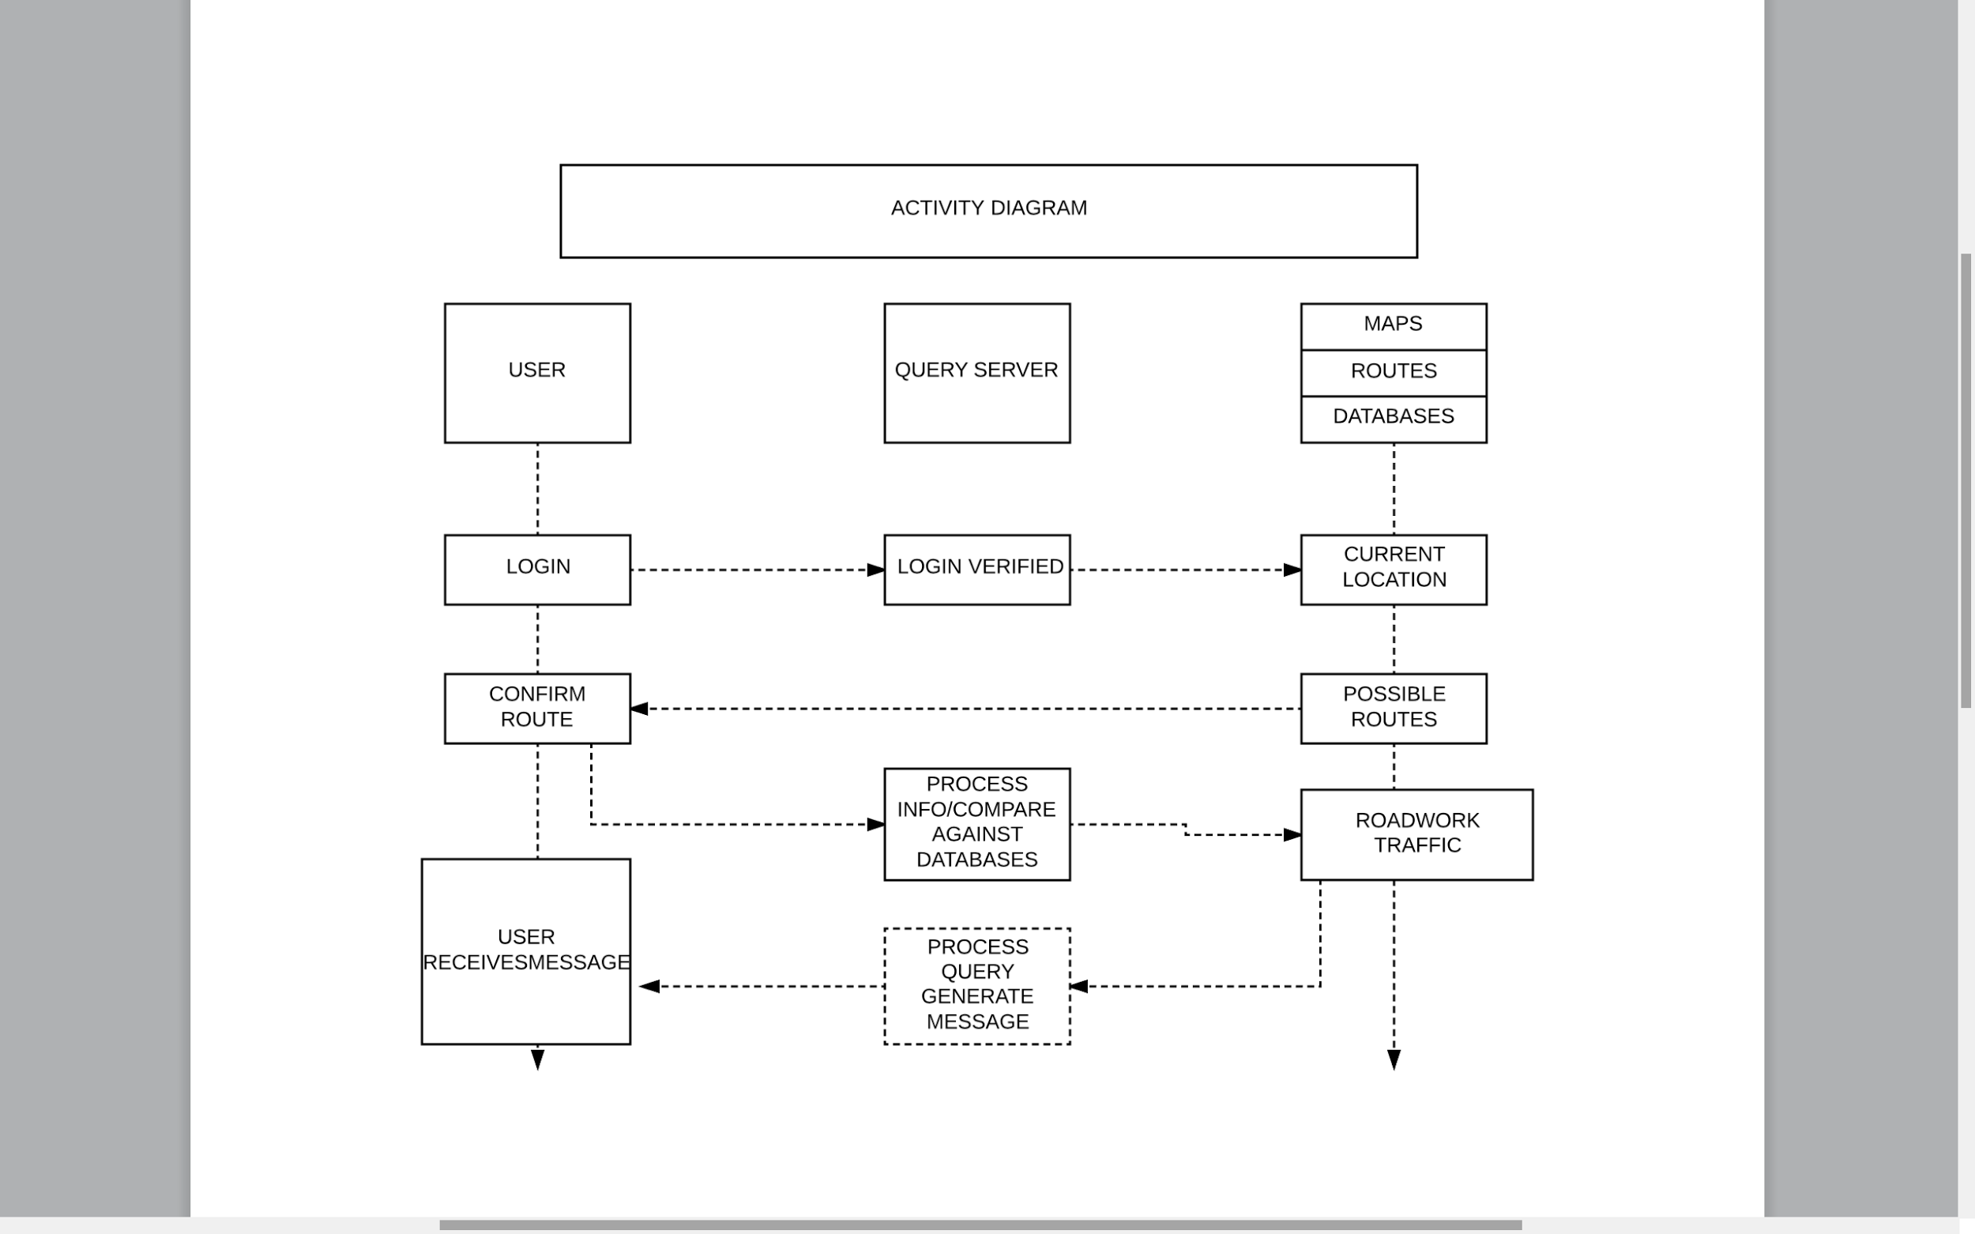
ACTIVITY DIAGRAM
Notes:
Here we broke down what the activities would look like from behind the scenes of our website. The process between the user and their experience.

Slide 15
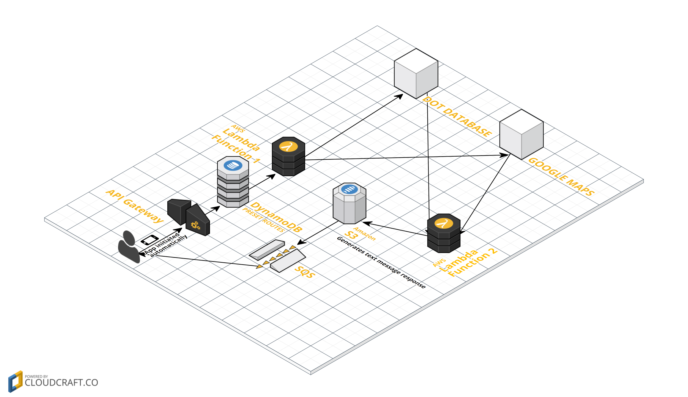
NETWORK DIAGRAM
Notes:
This diagram helps us understand the components involved in the network architecture of our operating app. This gives us a better idea of the services that might be required when operable. Understanding the factors involved is necessary to create a realistic budget to run the program. This allows us to introduce the initial prices to the user when launching the project.

Slide 16
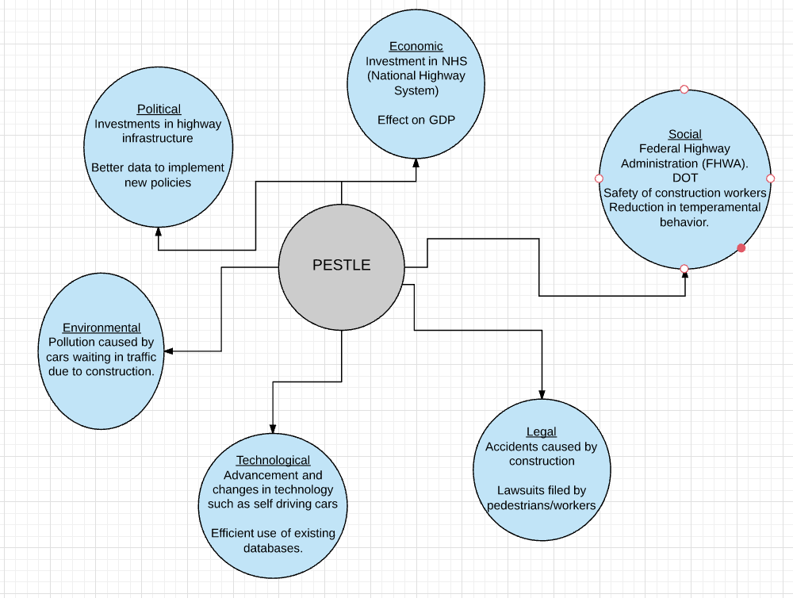
PESTLE Analysis
Notes:
The creation of a PESTLE analysis to discuss the political, economic, social, legal, technological and environmental aspects of the effects of construction on traffic.

Slide 17
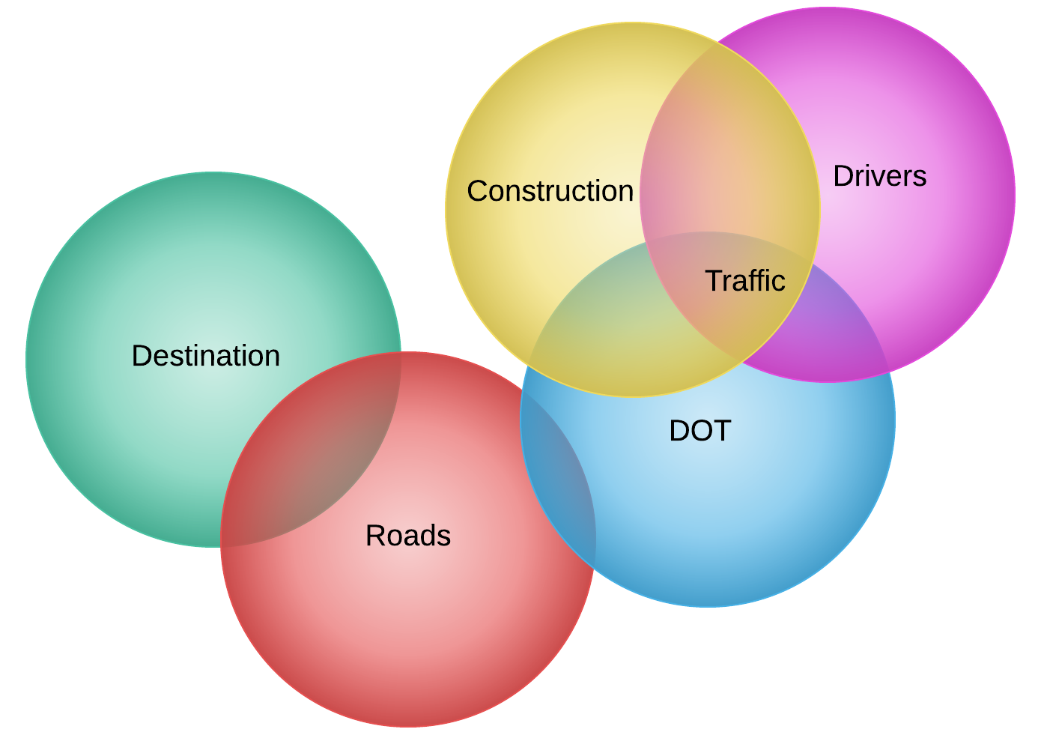
VENN DIAGRAM
Notes:
This venn diagram includes the different elements that are involved with highway traffic. Here we see that construction, the DOT, and drivers all overlap which leads to the problem that is traffic.

Slide 18
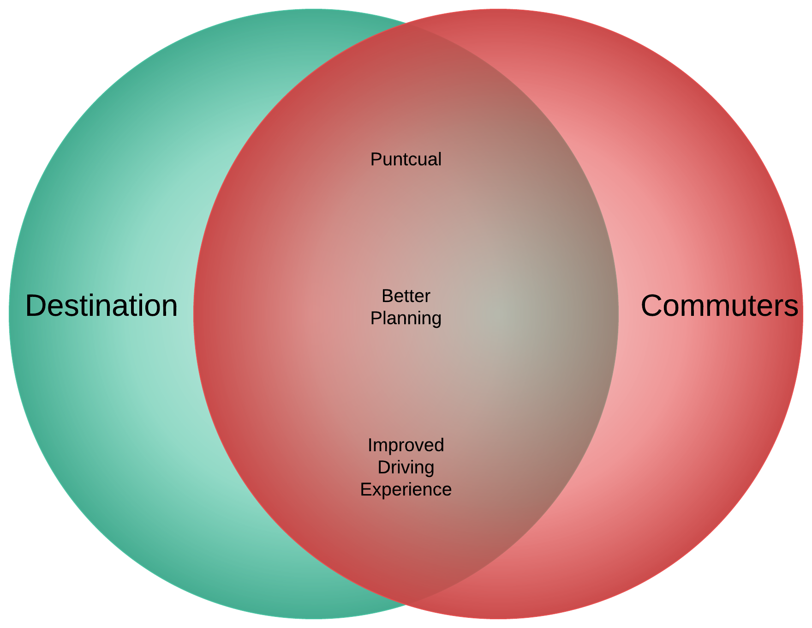
VENN DIAGRAM
Notes:
Venn diagram forced us to define the “why” in our project/application. This diagram was the most difficult and time-consuming due to the fact that we had to stay within the proximity of the reason we chose to move forward with our app.

Slide 19
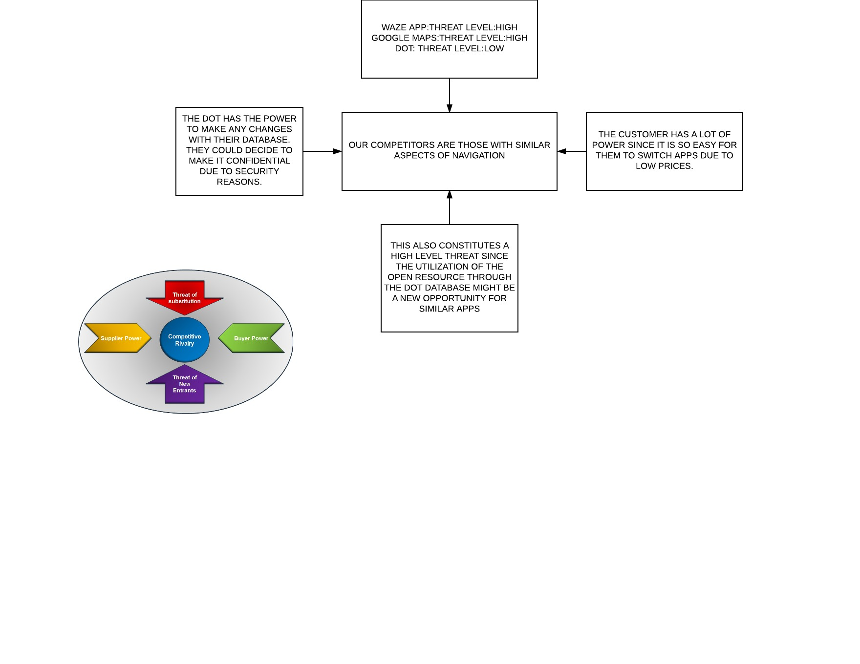
PORTER’S FIVE FORCES
Notes:
The purpose of this diagram is to analyze competition within our industry. For threat of substitution we have the waze app, google maps and the DOT. Waze app being the highest threat because of similar features that our app has. In the center we have competition rivalry, the competition being apps having navigation elements. The customer has almost all buyer power. The threat of new entrants would be applications that include open resources such as the DOT. The supplier buy would be the DOT, the DOT could any time decide to eliminate access to their database making our application useless.

